Slide 1



Bayesian Graphical Modeling
A hands-on tutorial
Bayesian Methods for the Social Sciences II
n.sekulovski@uva.nl
Bayesiangraphicalmodeling.com
Credit for slides: Karoline Huth

Slide 2





Session setup
Part I: Context
Part II: Theory
Part III: Tutorial
Part IV: Practical
image: Flaticon.com

Slide 3
Session setup
Part III: Tutorial
Interpretation
Priors
Analysis (R)
image: Flaticon.com

Slide 4
interpretation

Slide 5
Two questions in network analysis
1
1
Is there an effect?
1
2
3
2
3
1
1
2
3
2
3
2
3
What is the effect?

Slide 6
Bayesian hypothesis testing
We use the Bayes factor as a continuous measure of support

Slide 7
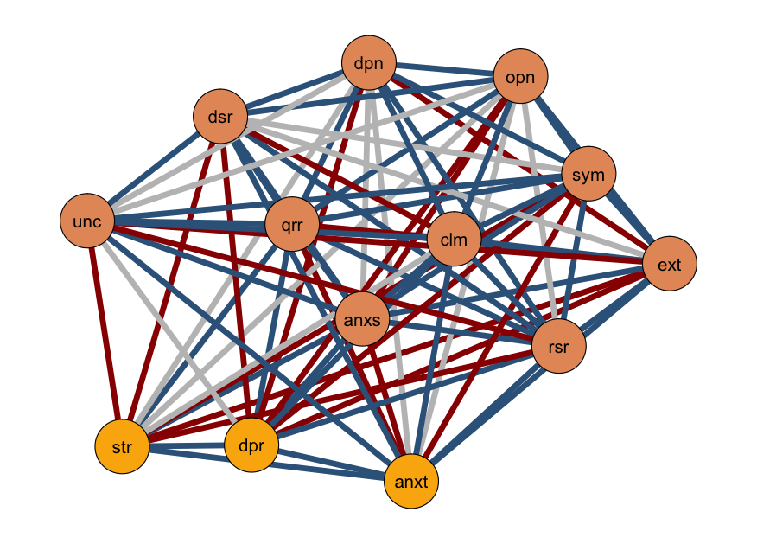
Edge evidence plot
Edge:
Inclusion Bayes factor for each edge (in categories)
Edge Color:
Evidence for inclusion
Inconclusive
Evidence for exclusion

Slide 8
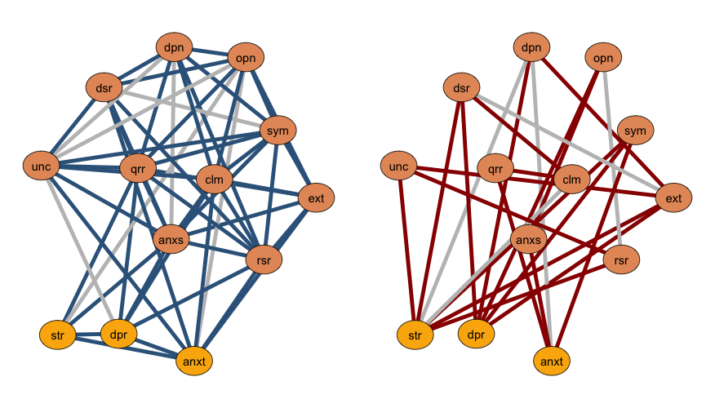
Edge evidence plot - split
Edges with a BF > 1; included
Edges with a BF < 1; excluded

Slide 9
Two questions in network analysis
1
1
Is there an effect?
1
2
3
2
3
1
1
2
3
2
3
2
3
What is the effect?

Slide 10
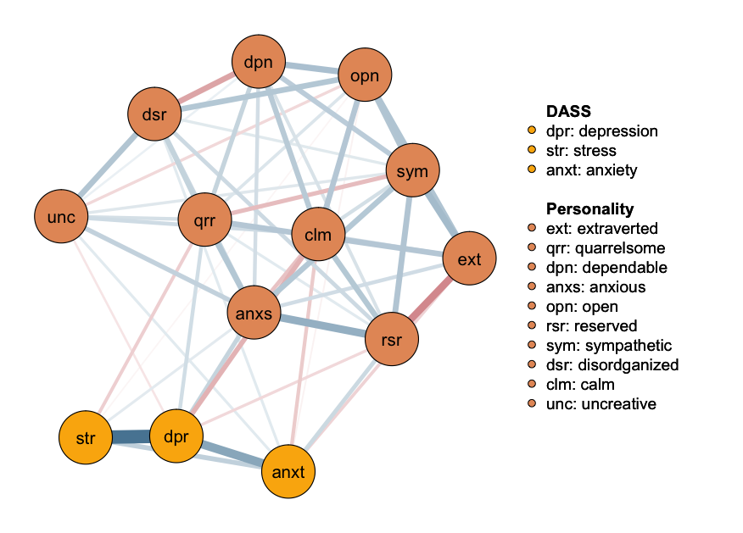
Network Plot
Median probability plot:
Edges with a BF > 1
Edge:
Partial association
parameter
Edge Color:
positive relations
negative relations

Slide 11
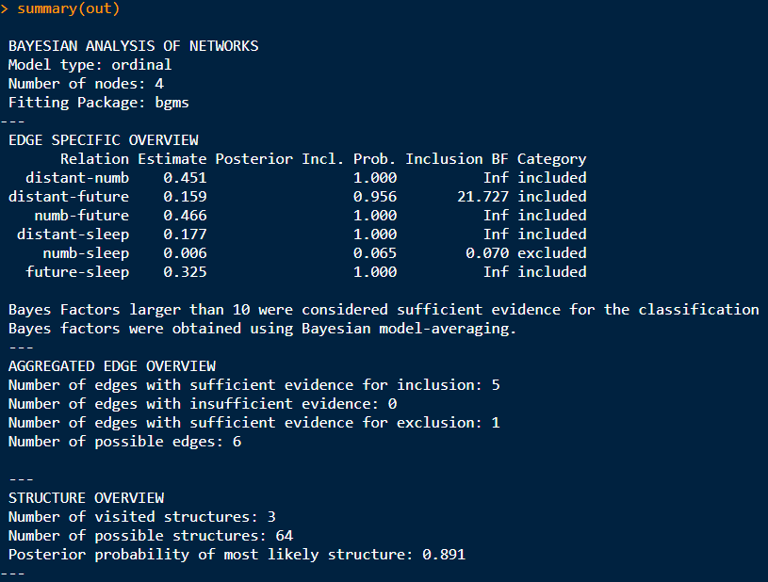
Combined Results – main output

Slide 12
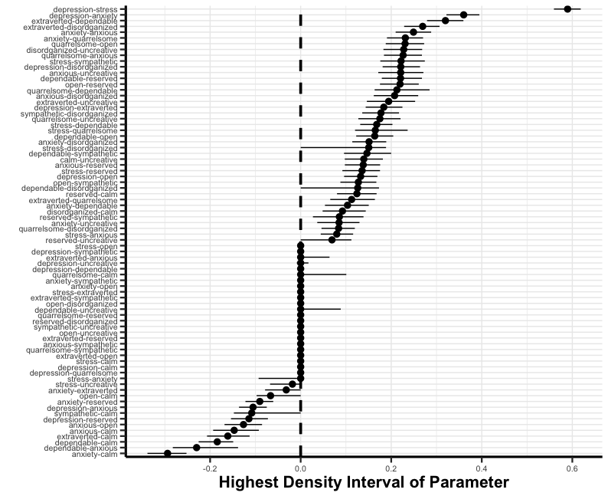
Forest plot
Highest density interval
Shortest interval covering 95% of the posterior mass

Slide 13
analysis

Slide 14


Software implementations
based on BDgraph
easybgm
all
BDgraph
mixed, continuous, ordinal, binary
BGGM
mixed, continuous, ordinal, binary
bgms
ordinal, binary

Slide 15
priors

Slide 16
Prior – specification
Structure Prior
What prior assumptions do I have about the density? Do I believe a particular edge should be included?
Options:
Independent Bernoulli
Beta-Binomial
Stochastic Block (to be announced soon)
Parameter Prior
What prior assumptions do I have about the strength of the edge weights?
Options:
Cauchy distribution (with an adjustable scale parameter)
Notes:
The unit information prior is a data-dependent prior, (typically multivariate Normal) with mean at the MLE, and precision equal to the information provided by one observation.

Slide 17
Resources
Huth, K. B. S., de Ron, J., Goudriaan, A. E., Luigjes, J., Mohammadi, R., van Holst, R. J., Wagenmakers, E.-J., & Marsman, M. (2023). Bayesian analysis of cross-sectional networks: A tutorial in R and JASP. Advances in Methods and Practices in Psychological Science, 6(4).
Huth, K., Keetelaar, S., Sekulovski, N., van den Bergh, D., & Marsman, M. (2024). Simplifying Bayesian analysis of graphical models for the social sciences with easybgm: A user-friendly R-package. Advances
.in/psychology, e66366.
Marsman, M., van den Bergh, D., & Haslbeck, J. M. B. (in press). Bayesian Analysis of the Ordinal Markov Random Field. Psychometrika
Sekulovski, N., Keetelaar, S., Huth, K., Wagenmakers, E. J., van Bork, R., van den Bergh, D., & Marsman, M. (in press). Testing conditional independence in psychometric networks: An analysis of three Bayesian methods. Multivariate Behavioral Research.
https://bayesiangraphicalmodeling.com/
https://github.com/KarolineHuth/easybgm
https://maartenmarsman.github.io/bgms/

Slide 18



End of Part III
Part I: Context
Part II: Theory
Part III: Tutorial
Part IV: Practical
image: Flaticon.com

Slide 19
Access to the materials:
bayesiangraphicalmodeling.com/workshops

Slide 20
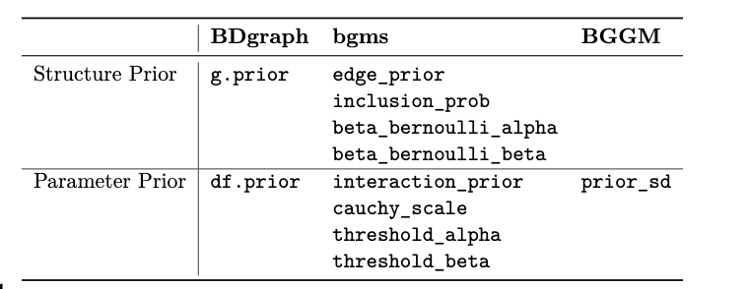
Prior – specification
Structure Prior
What prior assumptions do I have about the density? Do I believe a particular edge should be included?
Parameter Prior
What prior assumptions do I have about the strength of the edge weights?
scale

